Slide 1
Android Application – Requirement Tracker
CS673 Group 3:
Iteration 2
3/30/2016
Danny Chiu Brian Kabuye Ayodele Awoleye ChihYung Wu
Josh Wildey

Slide 2
Team Members
Danny Chiu
Team Leader|Requirement Leader|QA Leader
Brian Kabuye
Implementation Leader|App Developer
ChihYung Wu
Design Leader|App Developer
Ayodele Awoleye
Configuration Leader|Server Developer
Josh Wildey
Environment & Integration Leader|Server Developer

Slide 3
Main Objective
We want to create a functional Android application of the Requirement Tracker tool that is on the 3Blueprints website.

Slide 4
Essential Features
User Login Screen
Able to login/create an user account.
View list of different projects for each account
Logging in should bring user to main menu where all the projects associated with account will be listed.
Option to create and modify user stories.
Able to create new user story.
Able to edit/delete each data field.

Slide 5
Iteration 2
Main Objectives
Working functions to create new, edit and delete user stories.
Make sure all data is stored on backend database.

Slide 6
Process Improvement
Lack of communication - started to meet in person on the weekend to work on project.

Slide 7
Tasks/Accomplishments
UI Tasks
Create layout for project info and edit page.
Create layout for user story info and edit page.
Create layout for iteration info and edit page.
Create layout for user list info and edit page.

Slide 8
Tasks/Accomplishments
Code Tasks
Create function for displaying project name and description.

Slide 9
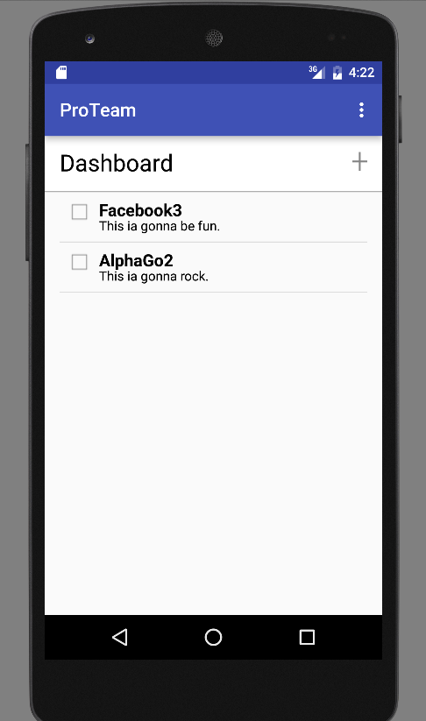
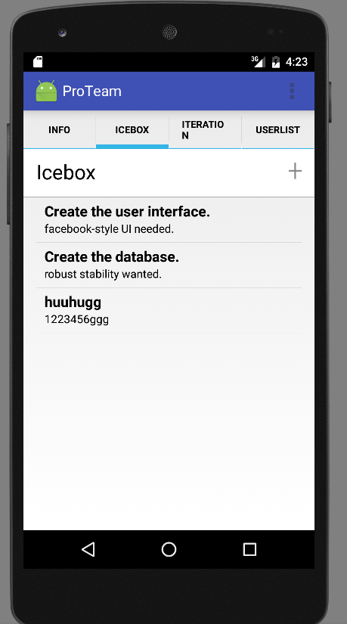
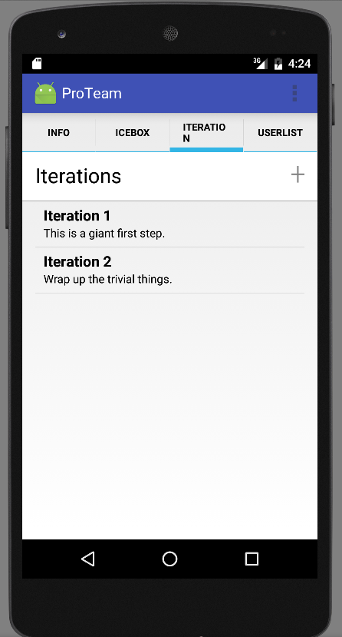
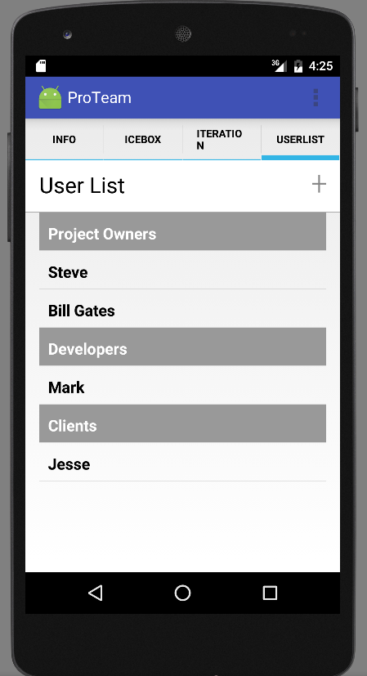

Slide 10
Backend Development
Requirements
all data communicated through REST API
Django performs the authentication of a user.
Android application must send the JSON web token in every request to the API (in the header of the http request)

Slide 11
Requirements Analysis
User Stories
As a developer, I want to authenticate an existing user by making a HTTP Post API call to the existing Django API
As a user, I want to be able to log-in to my account
As a user, I want to be able to view the project i’m currently working on
As a user, I want to able to view the user stories associated with the project I’m currently working on.

Slide 12
Tasks
Expose web token over the API if a user is successfully authenticated.
Add new urls to expose data objects over the API
Expose the project(s) the current user is working on
Expose user stories that were created in the project.

Slide 13
Understanding the Current System
Django/Python server does the heavy lifting.(Authentication, database management e.t.c)
Android Application communicates to Backend Server through API with JSON application requests(GET and POST)

Slide 14
Accomplishments
API provides the list of projects but doesn’t have filtering capabilities by user.
A signed in user can also view user stories in the current project.

Slide 15
DEMO

